Slide 1

ISCG6420 Node JS
Semester 1, 2017
Notes:
Use title slide layout

Slide 2
What is Node.js?
JS runtime built on Chrome’s V8 JS engine
Node is JS running on the server (no longer runs in the browser only)
Hence, more complicated apps can now be built
Node.js is has an event-driven architecture capable of asynchronous I/O
This leads to optimization and scalability in web applications with many input/output operations, as well as for real-time web applications (browser games)

Slide 3
NPM
Node Package Manager
Used to install node programs
Easy to specify dependencies
Modules get installed into “node_modules” folder

Slide 4
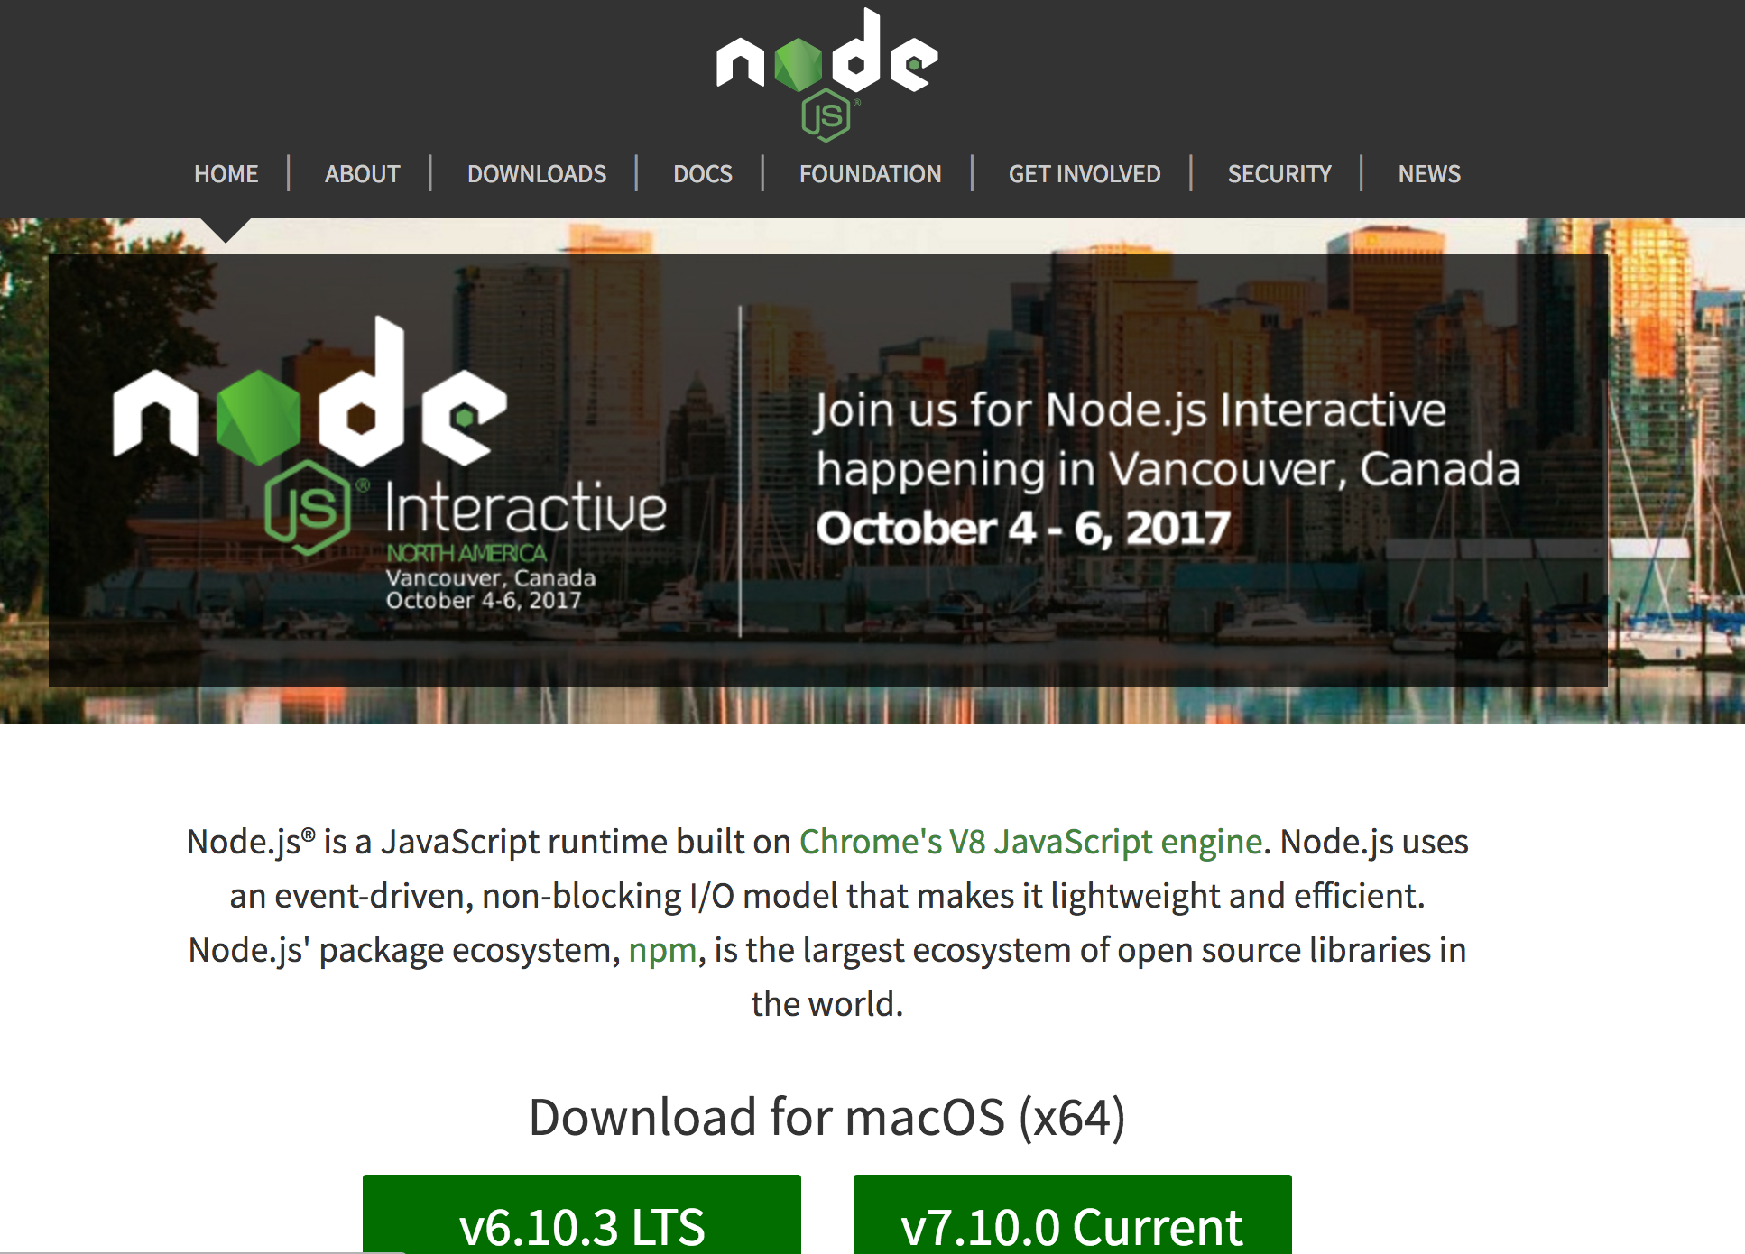
Let’s install Node

Slide 5
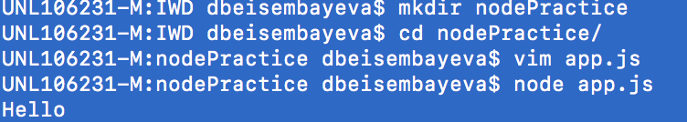
Using CMD, create a directory called nodePractice
Then create a simple file called app.js and console.log() some message
Then in CMD type node app.js and you should see your message

Slide 6
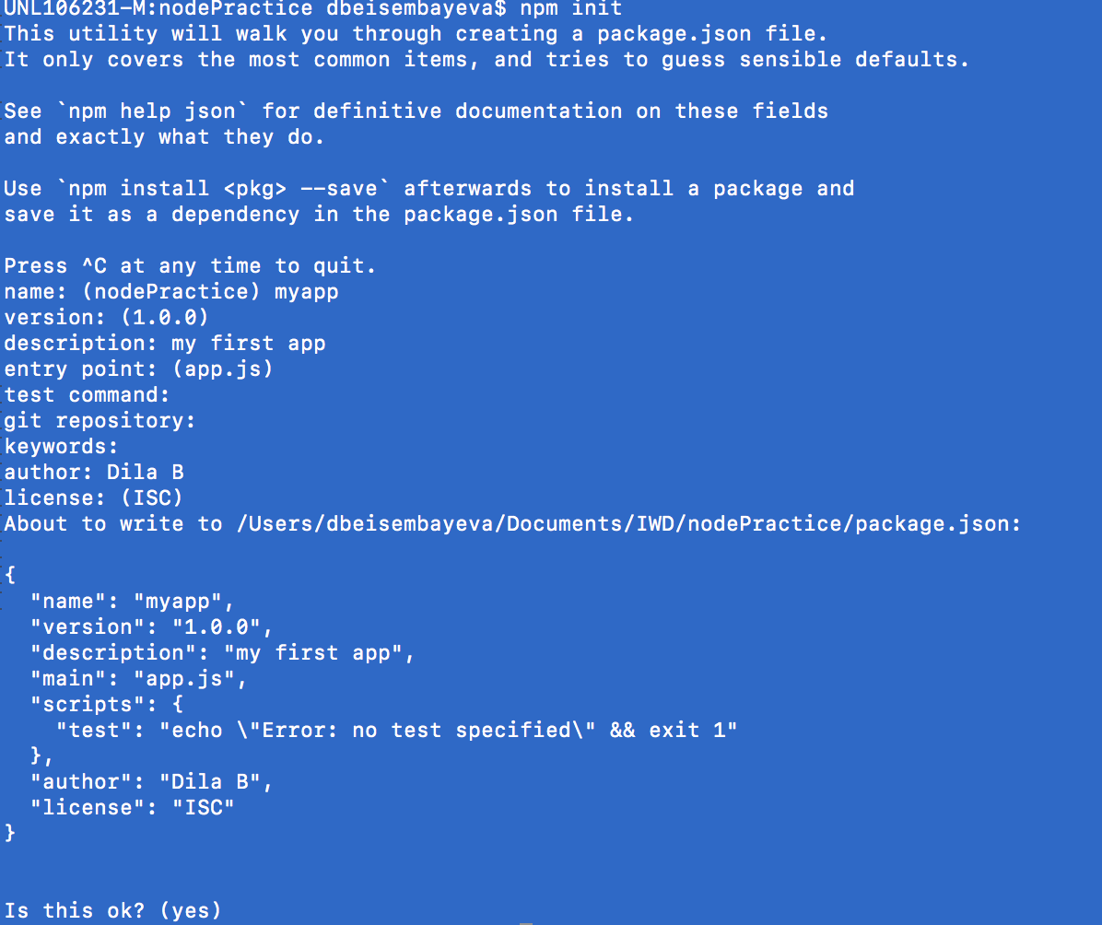

Slide 7
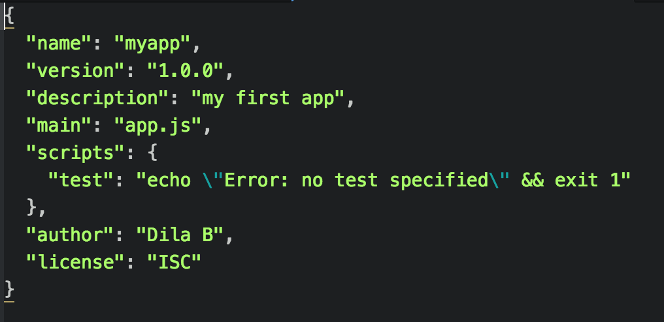
Now in your directory you should see a file called package.json
Open it with your preferred text editor

Slide 8
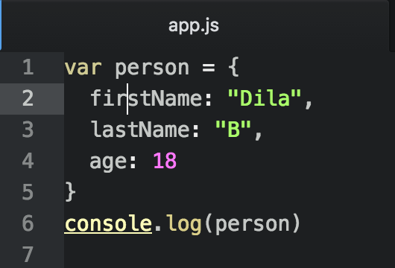

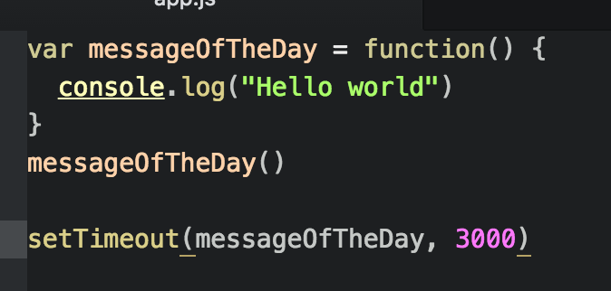
Looks the same as any other JS file:

Slide 9
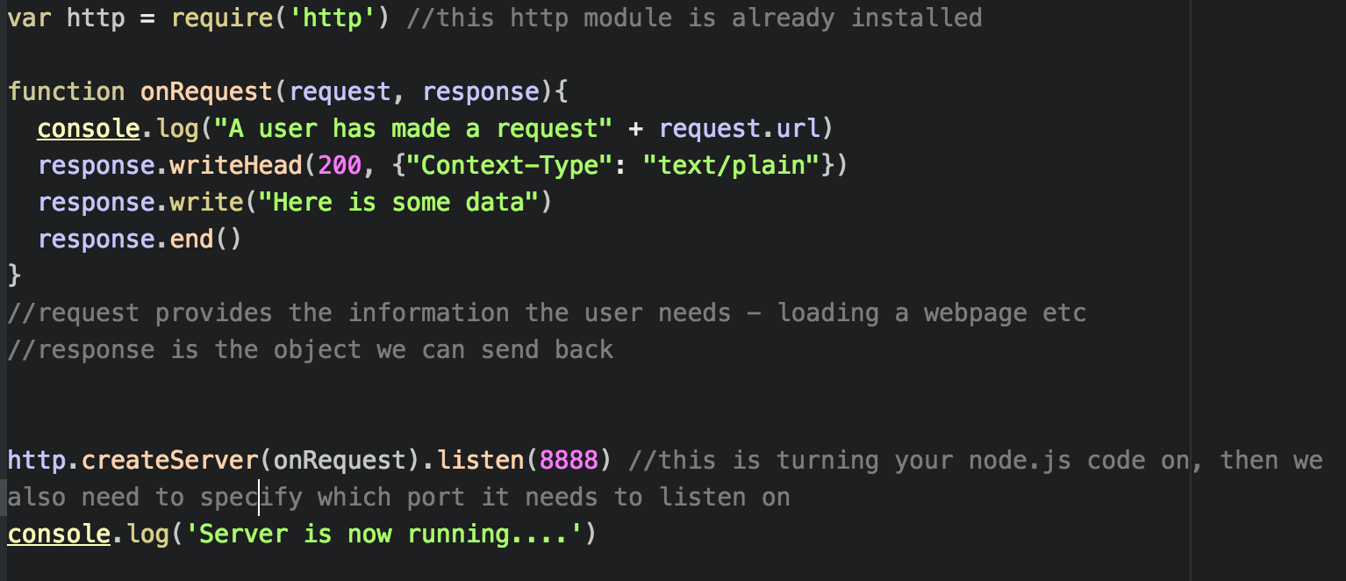
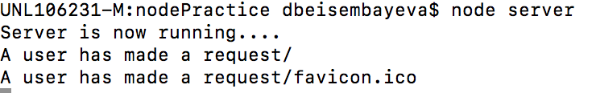
Creating a basic server

Slide 10
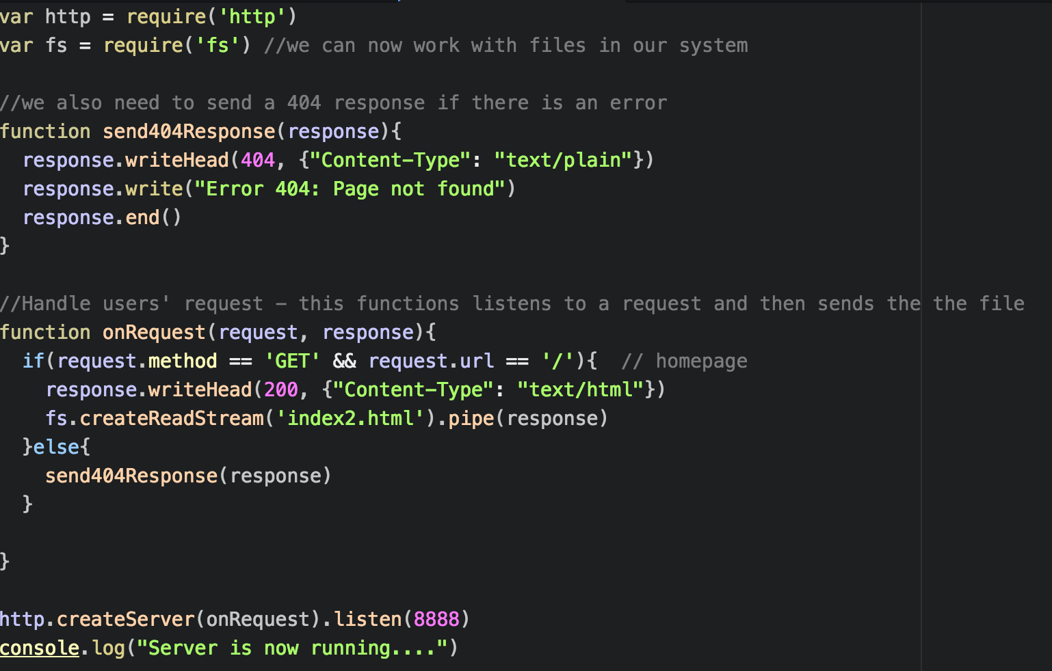

Slide 11
You must also have some random html file.
Run the server and see what happens
In order to see the error message, instead of index2.html, type index3

Slide 12
Express JS
ExpressJS is a minimalistic, open source web framework for Node.js
We need Node.js and NPM

Slide 13
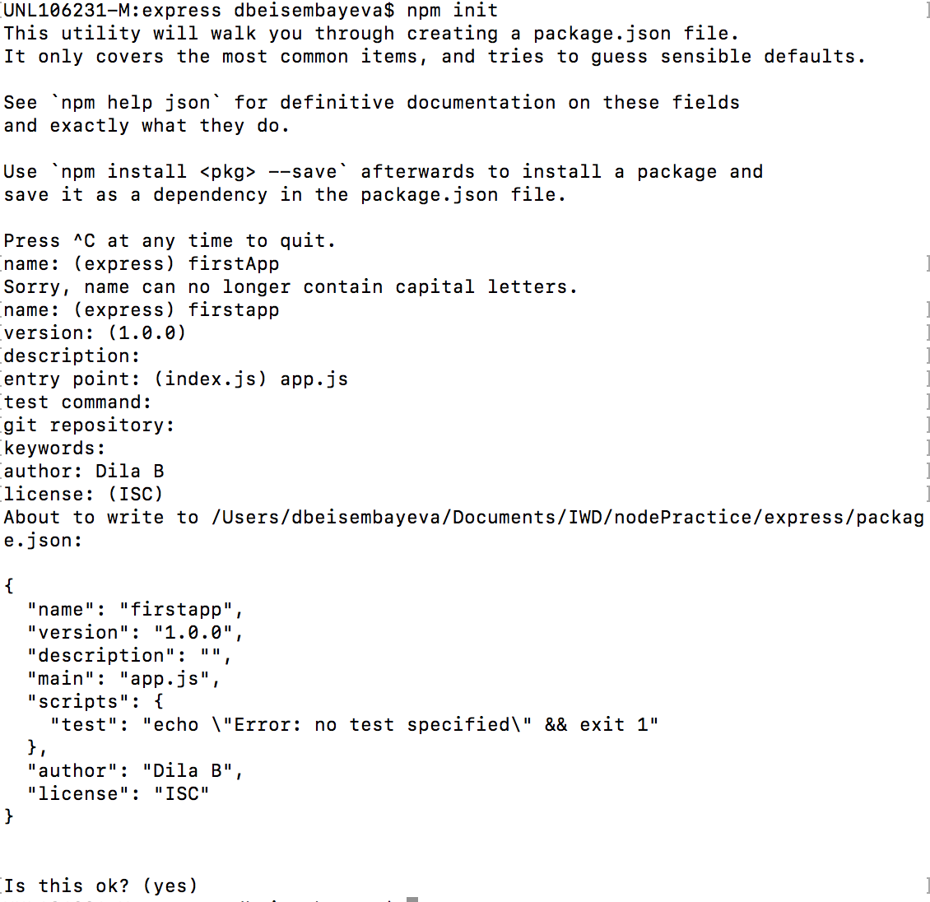

Slide 14
Now install express within dir
npm install express –save
npm install body-parser –save
Check package.json file to ensure all dependencies installed correctly
Create a new file – ensure it’s called the same as your entry file

Slide 15
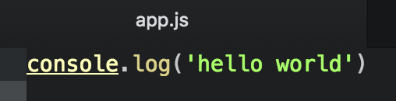

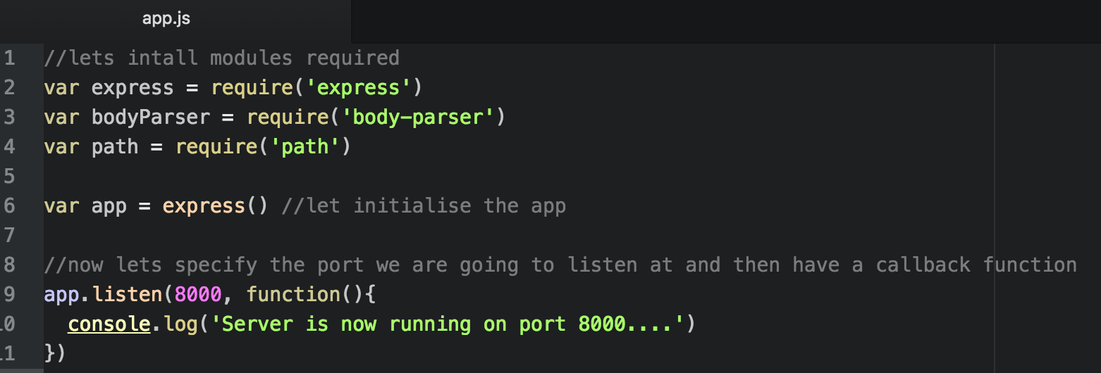


/ means that it cannot get the home route

Slide 16
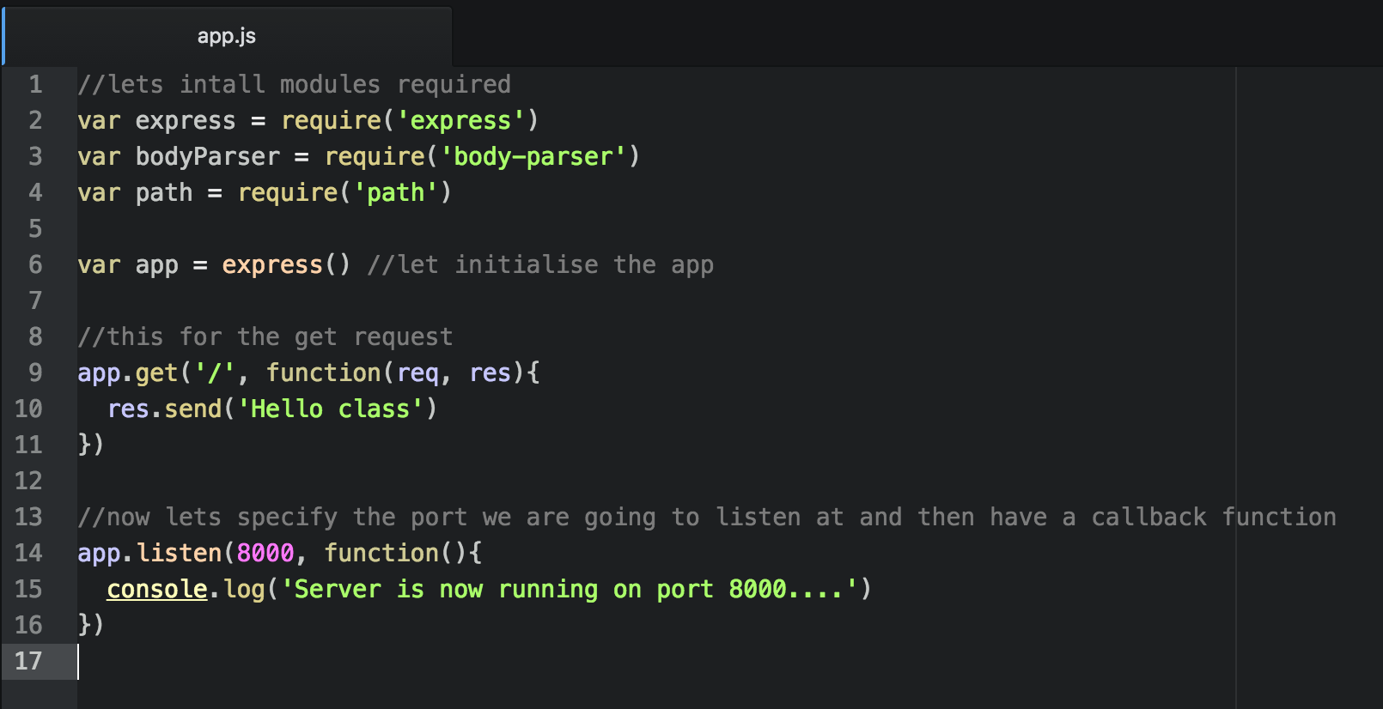

Slide 17
Installing nodemon
Nodemon is a utility that will monitor for any changes in your source and automatically restart your server
Install it using npm
Just use nodemon instead of node to run your code and now your process will automatically restart when your code changes
npm install –g nodemon
Now try to change something in your app.js and refresh the page – no need to restart the server

Slide 18
Installing EJS
E stands for effective
EJS is a simple templating language that lets you generate HTML markup with plain JS
npm install ejs –-save

Slide 19
Validation with express-validator
Check out the github page for further info
npm install express-validator --save

